Slide 1
NeLS and StoreBioinfo storage Projects and storage layers
Dorota Buczek
ELIXIR Norway, Norwegian e-infrastructure for Life Sciences and usegalaxy.no

Slide 2
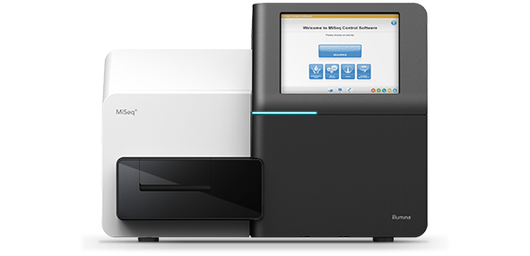
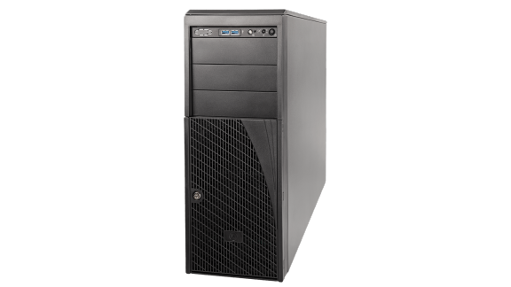
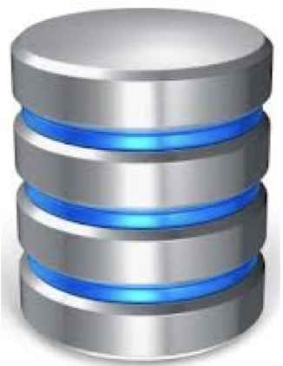
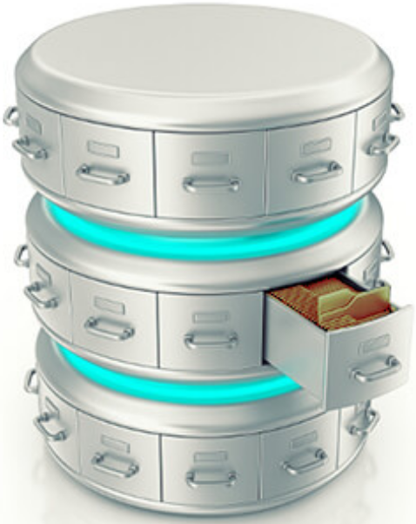







Overview of data management
FAIR data management from sequencing provider to public repository
Data production
Data storage/sharing
Data compute
Data archiving
Data management
Notes:
This involves capturing metadata as early as possible
the Norwegian Consortium for Sequencing and Personalized Medicine
To store non-sensitive NeLS
Sensitive TSD
NIRD

Slide 3
Content of introduction slides
Architecture view - different layers with different purposes
Look briefly at the how the two different layers looks like in the NeLS interface
A few words about roles -> describe what you contribute and have access to do
Some more details on working with the StoreBioinfo layer
Requires data types and structured data
Preparations before transferring data from NeLS to StoreBioinfo
Notes:
Either with FEIDE login NeLS login for non-FEIDE users (eg. External collaborators)
Possible to access through the portal or through ssh (and API)

Slide 4
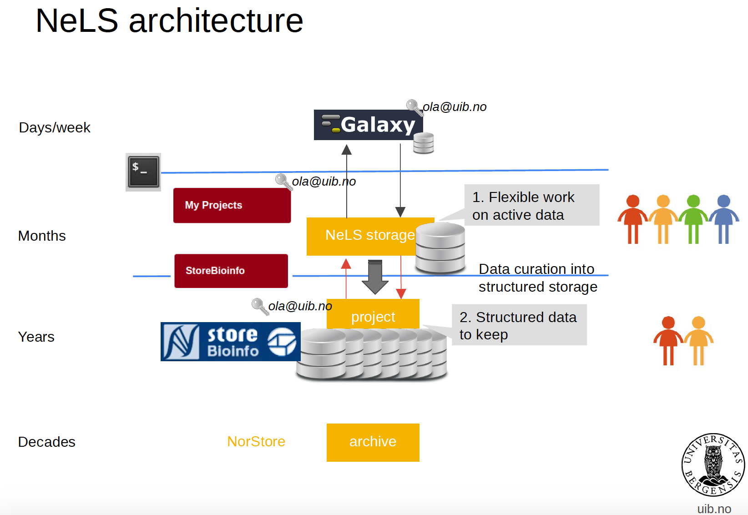




NeLS architecture
Research data archive
Notes:
The architecture of NeLS has a tiered structure, with three natural layers that data can reside in. These are the compute layer (usegalaxy.no), the NeLS storage layer, and the StoreBioinfo layer. All three serve different purposes in terms of usage: from small capacity, very short term immediate storage with fast access available to compute resources, to large capacity, long term storage, with less flexible access methods and longer access time.
NeLS in general
Available to all Norwegian researchers
Enable collaborative projects
Multiple storage layers
Integrated with compute
Multiple permission roles - shared data
Free of charge*
Support for data deposition
User support: Elixir Norway helpdesk
Storage application needed for projects where data is shared by many users
Access via FEIDE user or NeLS idp can be made for non-FEIDE users
Free storage < 10 TB
StoreBioInfo (SBI) is for long term storage of project data. A storage quota in this layer is granted upon a successful application to ELIXIR Norway support desk

Slide 5
Data from data providers
Research data archive
Notes:
Directly deposited into NeLS/SBI

Slide 6
Data storage in NeLS and StoreBioInfo
Research data archive
Notes:
Common for all: sharing of data between members of the project different permissions (read-only, reads-write, PI can add people to the project)

Slide 7
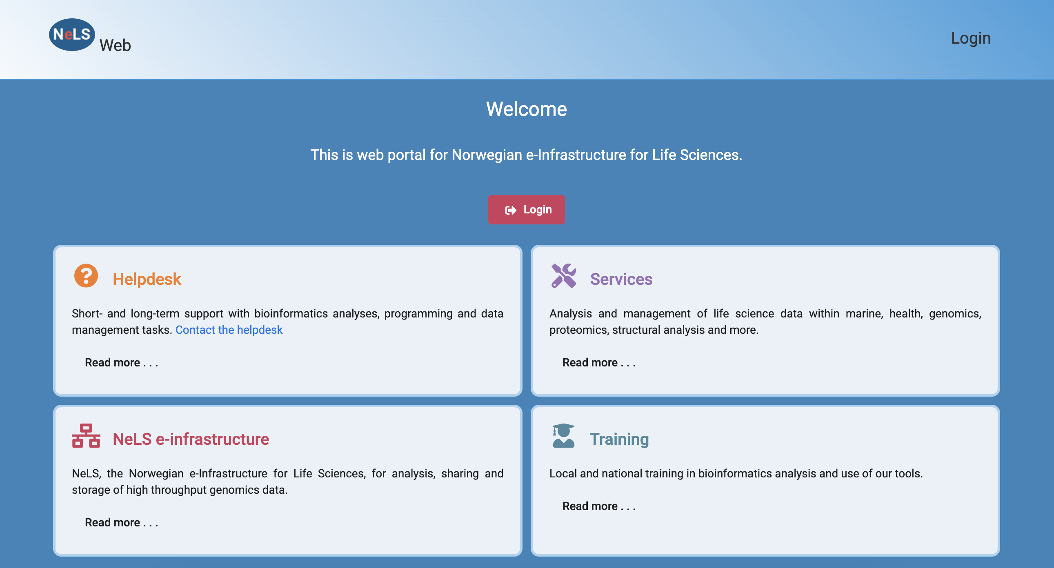
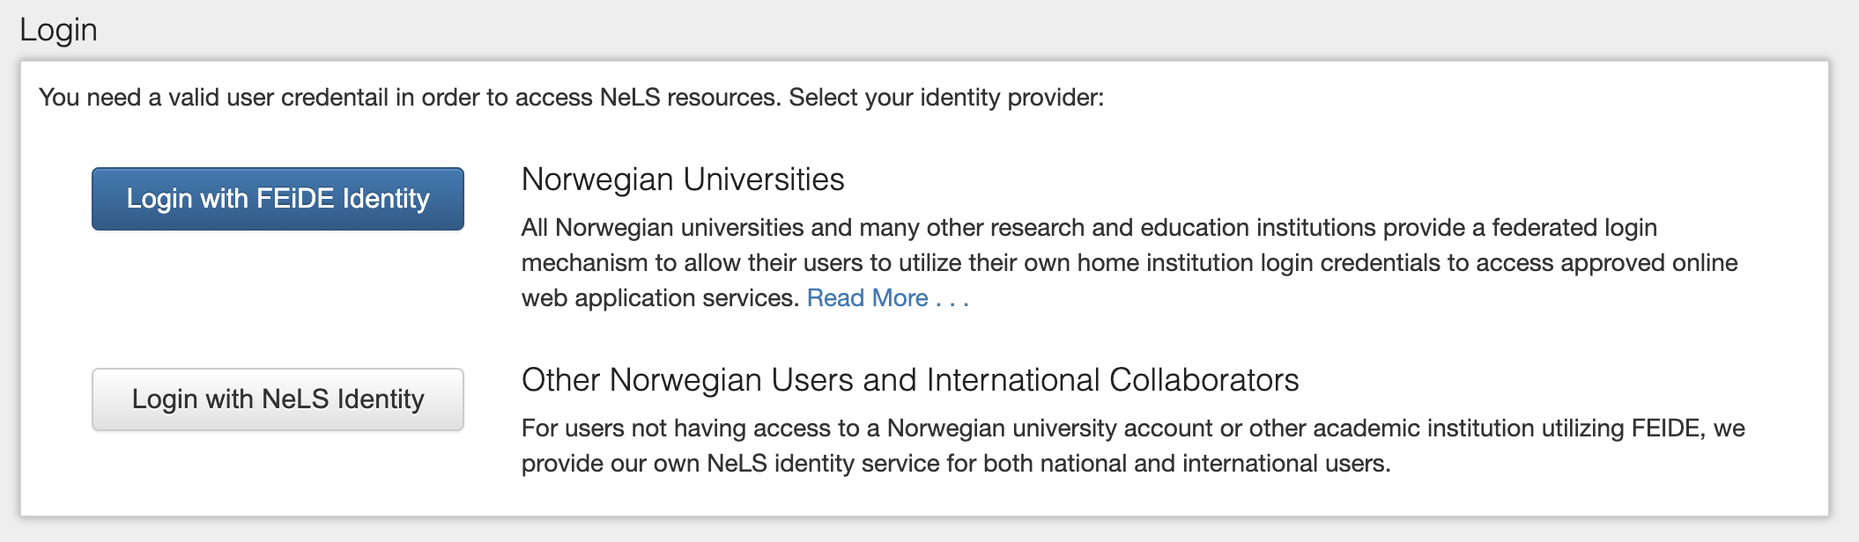
Access to storage and sharing of data in NeLS
Temporary storage – typically during the data analysis and manuscript preparation
Users with permissions can access data in a NeLS project (FEIDE or NeLS ID)
Notes:
Either with FEIDE login NeLS login for non-FEIDE users (eg. External collaborators)
Possible to access through the portal or through ssh (and API)

Slide 8
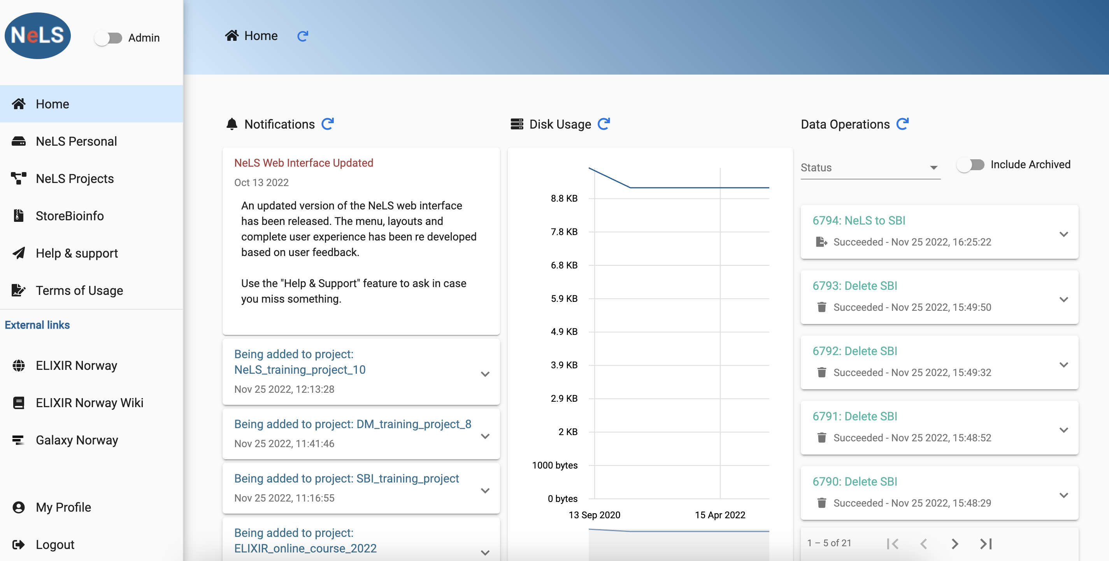
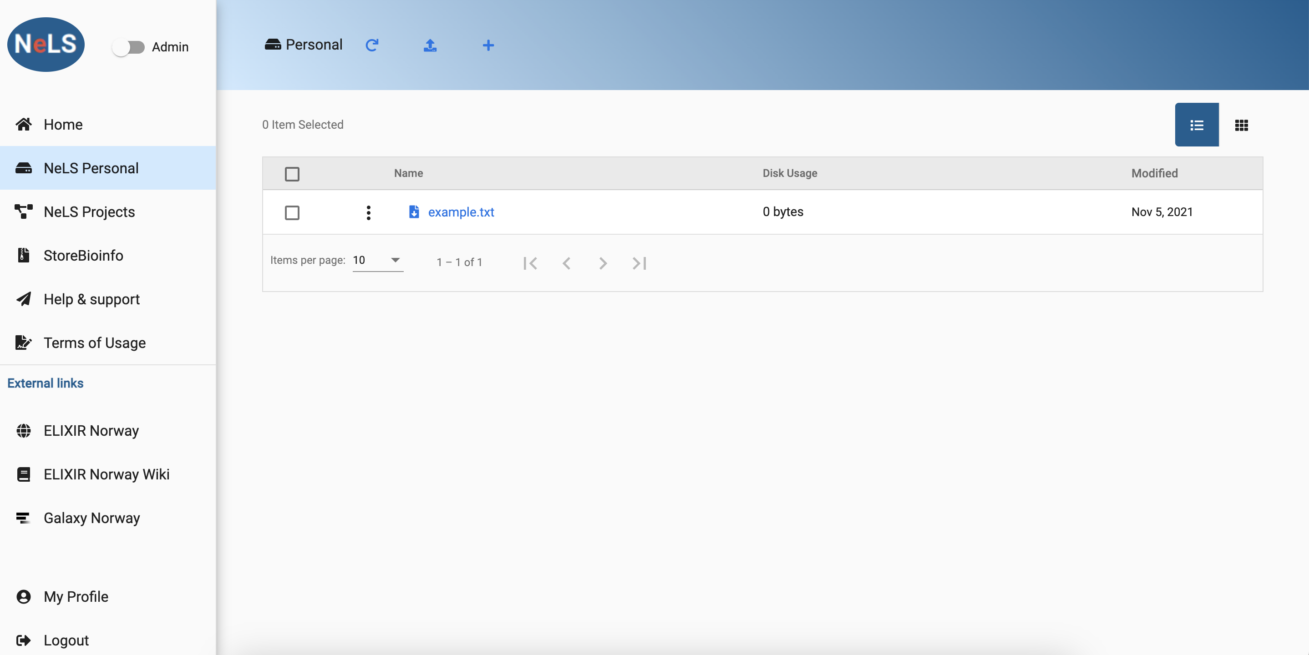
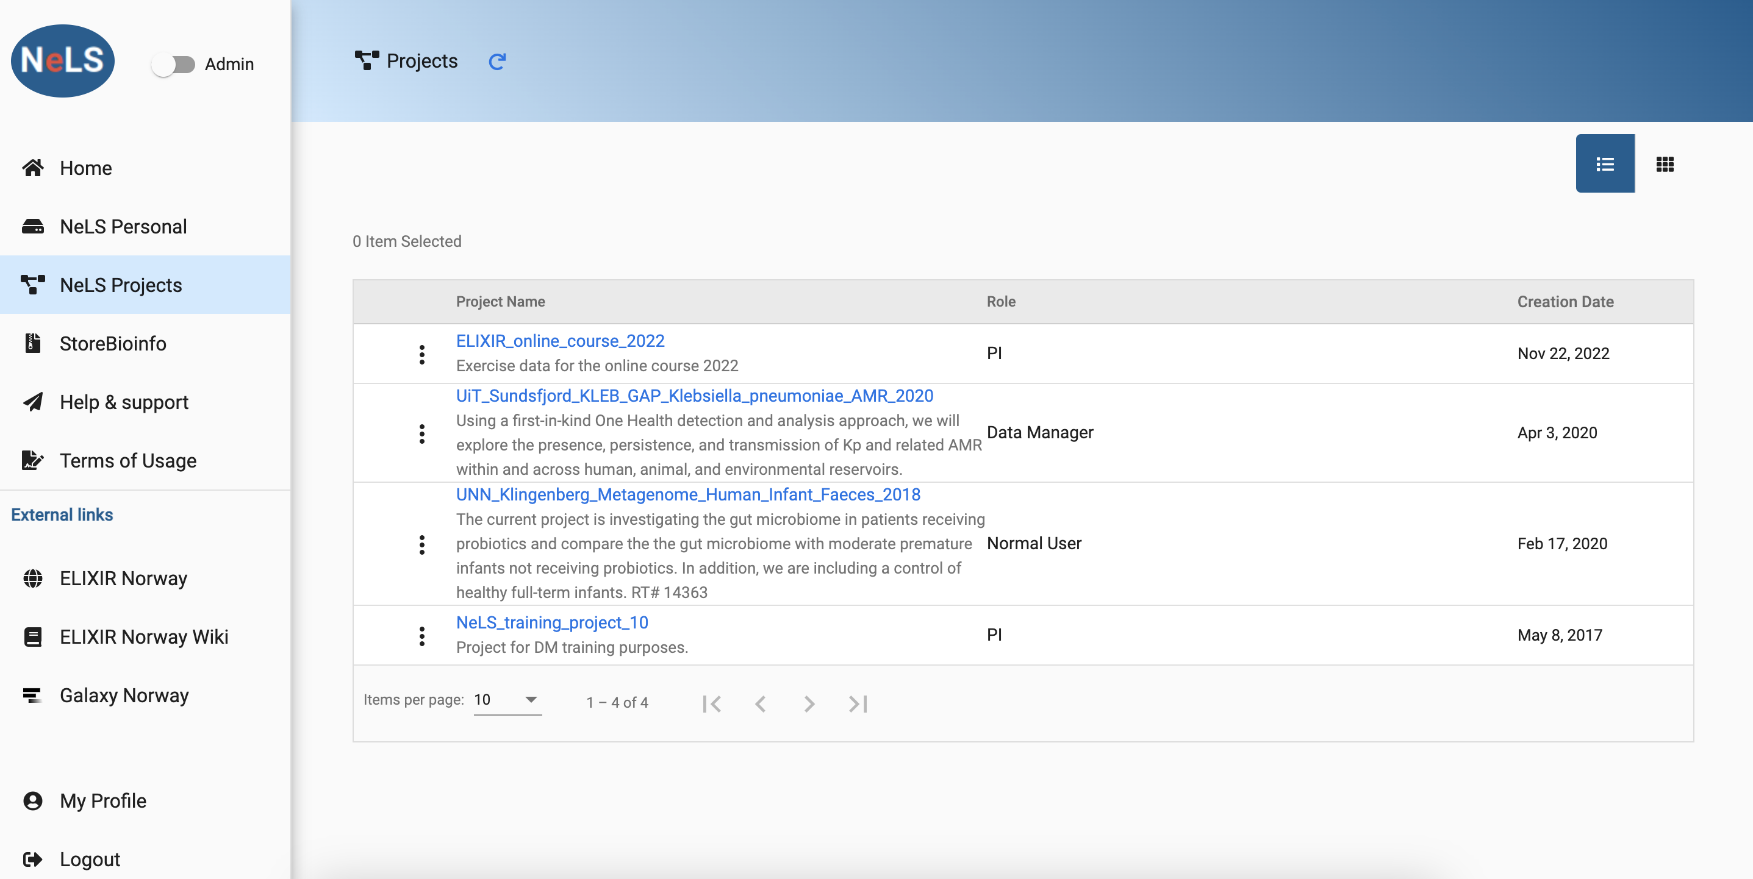
Access to storage and sharing of data in NeLS
Access to personal storage and projects
Notes:
Access to personal storage and projects and SBI
Managing data – different roles

Slide 9
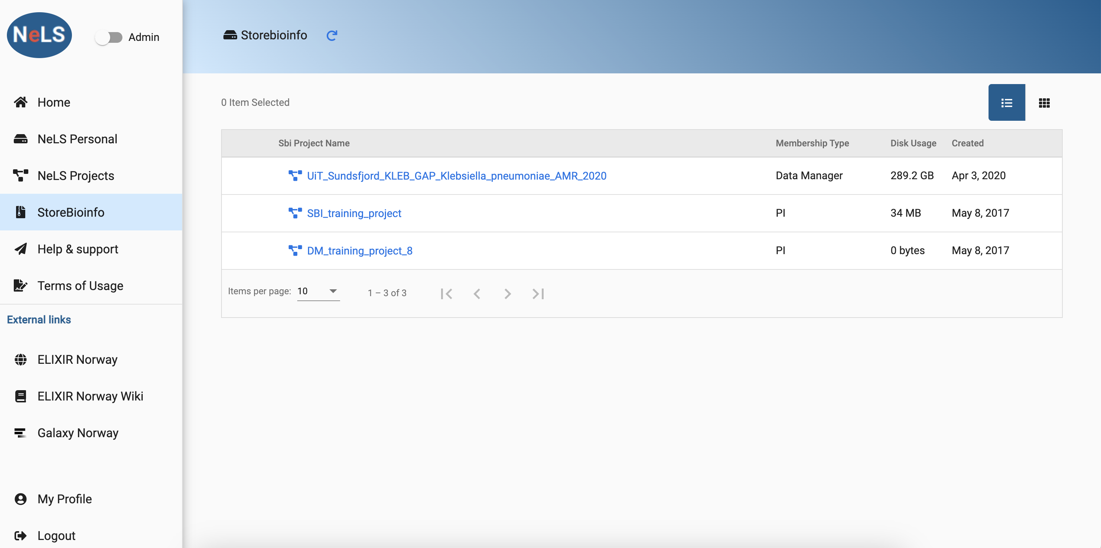
Data storage in StoreBioInfo
Long term storage – typically for large projects where data is used in several publications
Storage quotas has to be applied for – typically > 1TB data

Slide 10
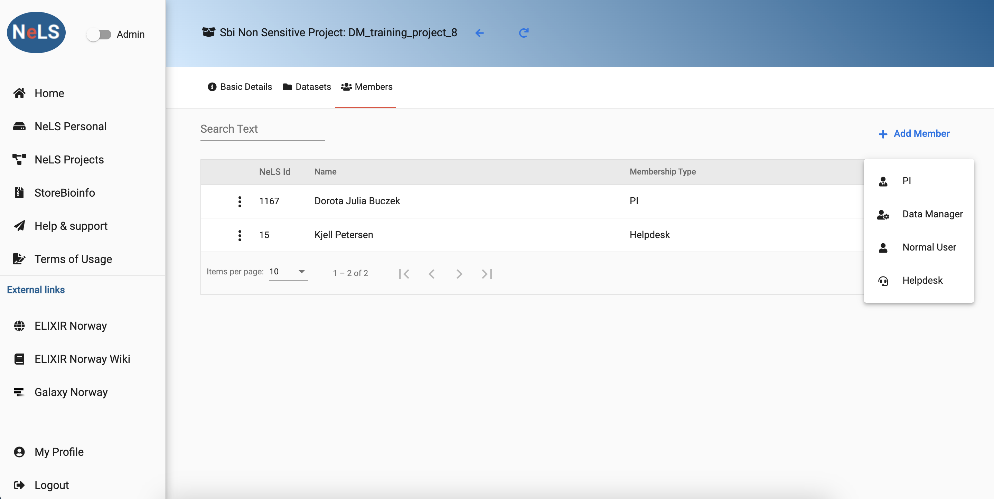
Collaboration through roles in a team
In both NeLS and StoreBioinfo projects your user profile gets permissions to work with data (upload, rename, move, delete, update) based on a role in a project.

Slide 11
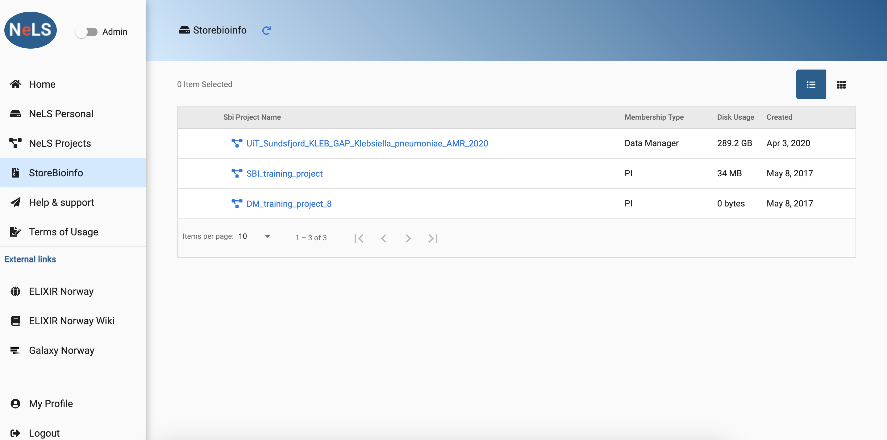
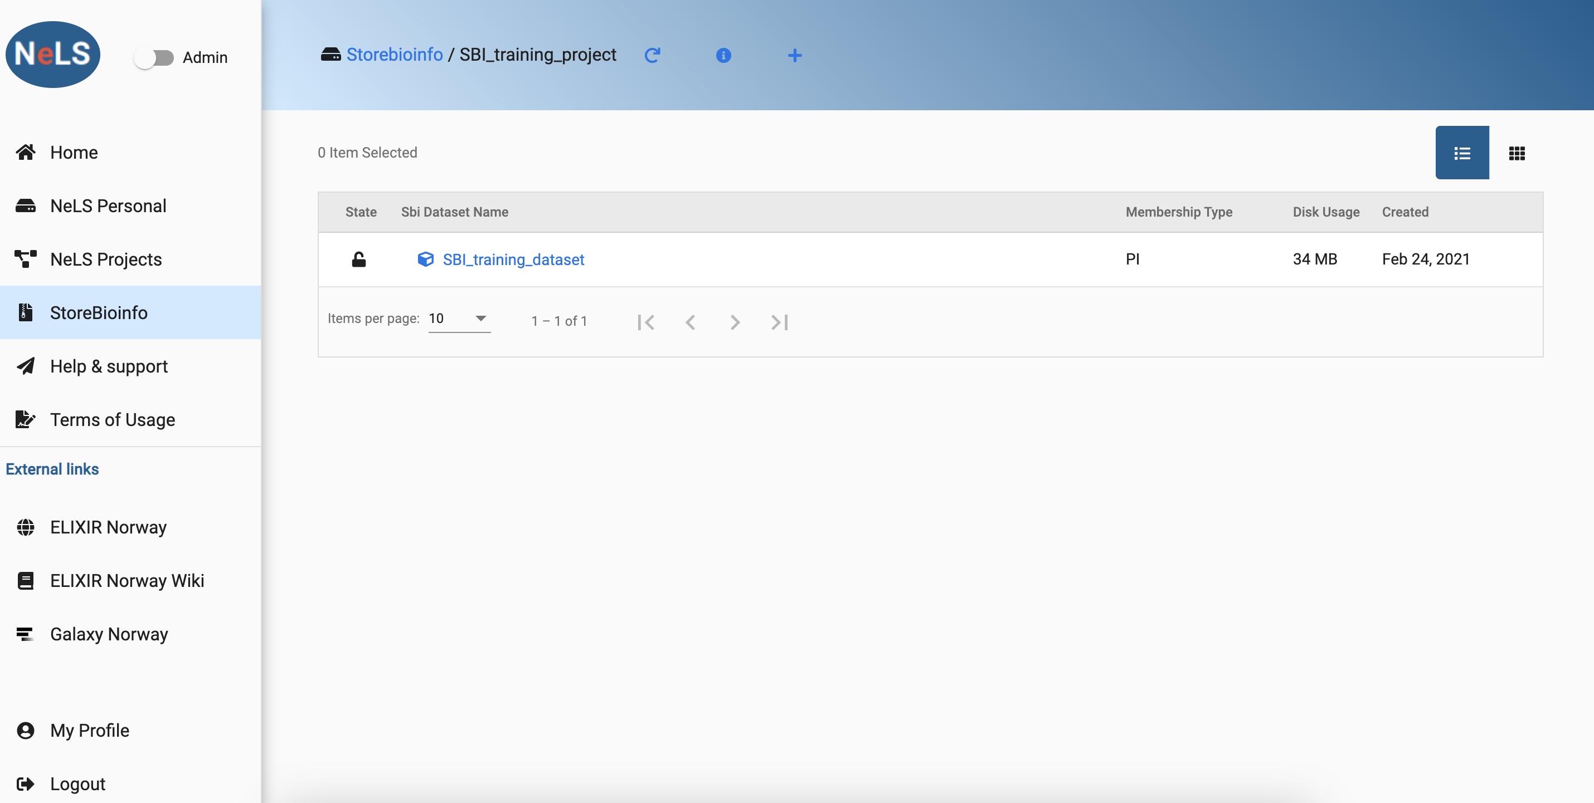
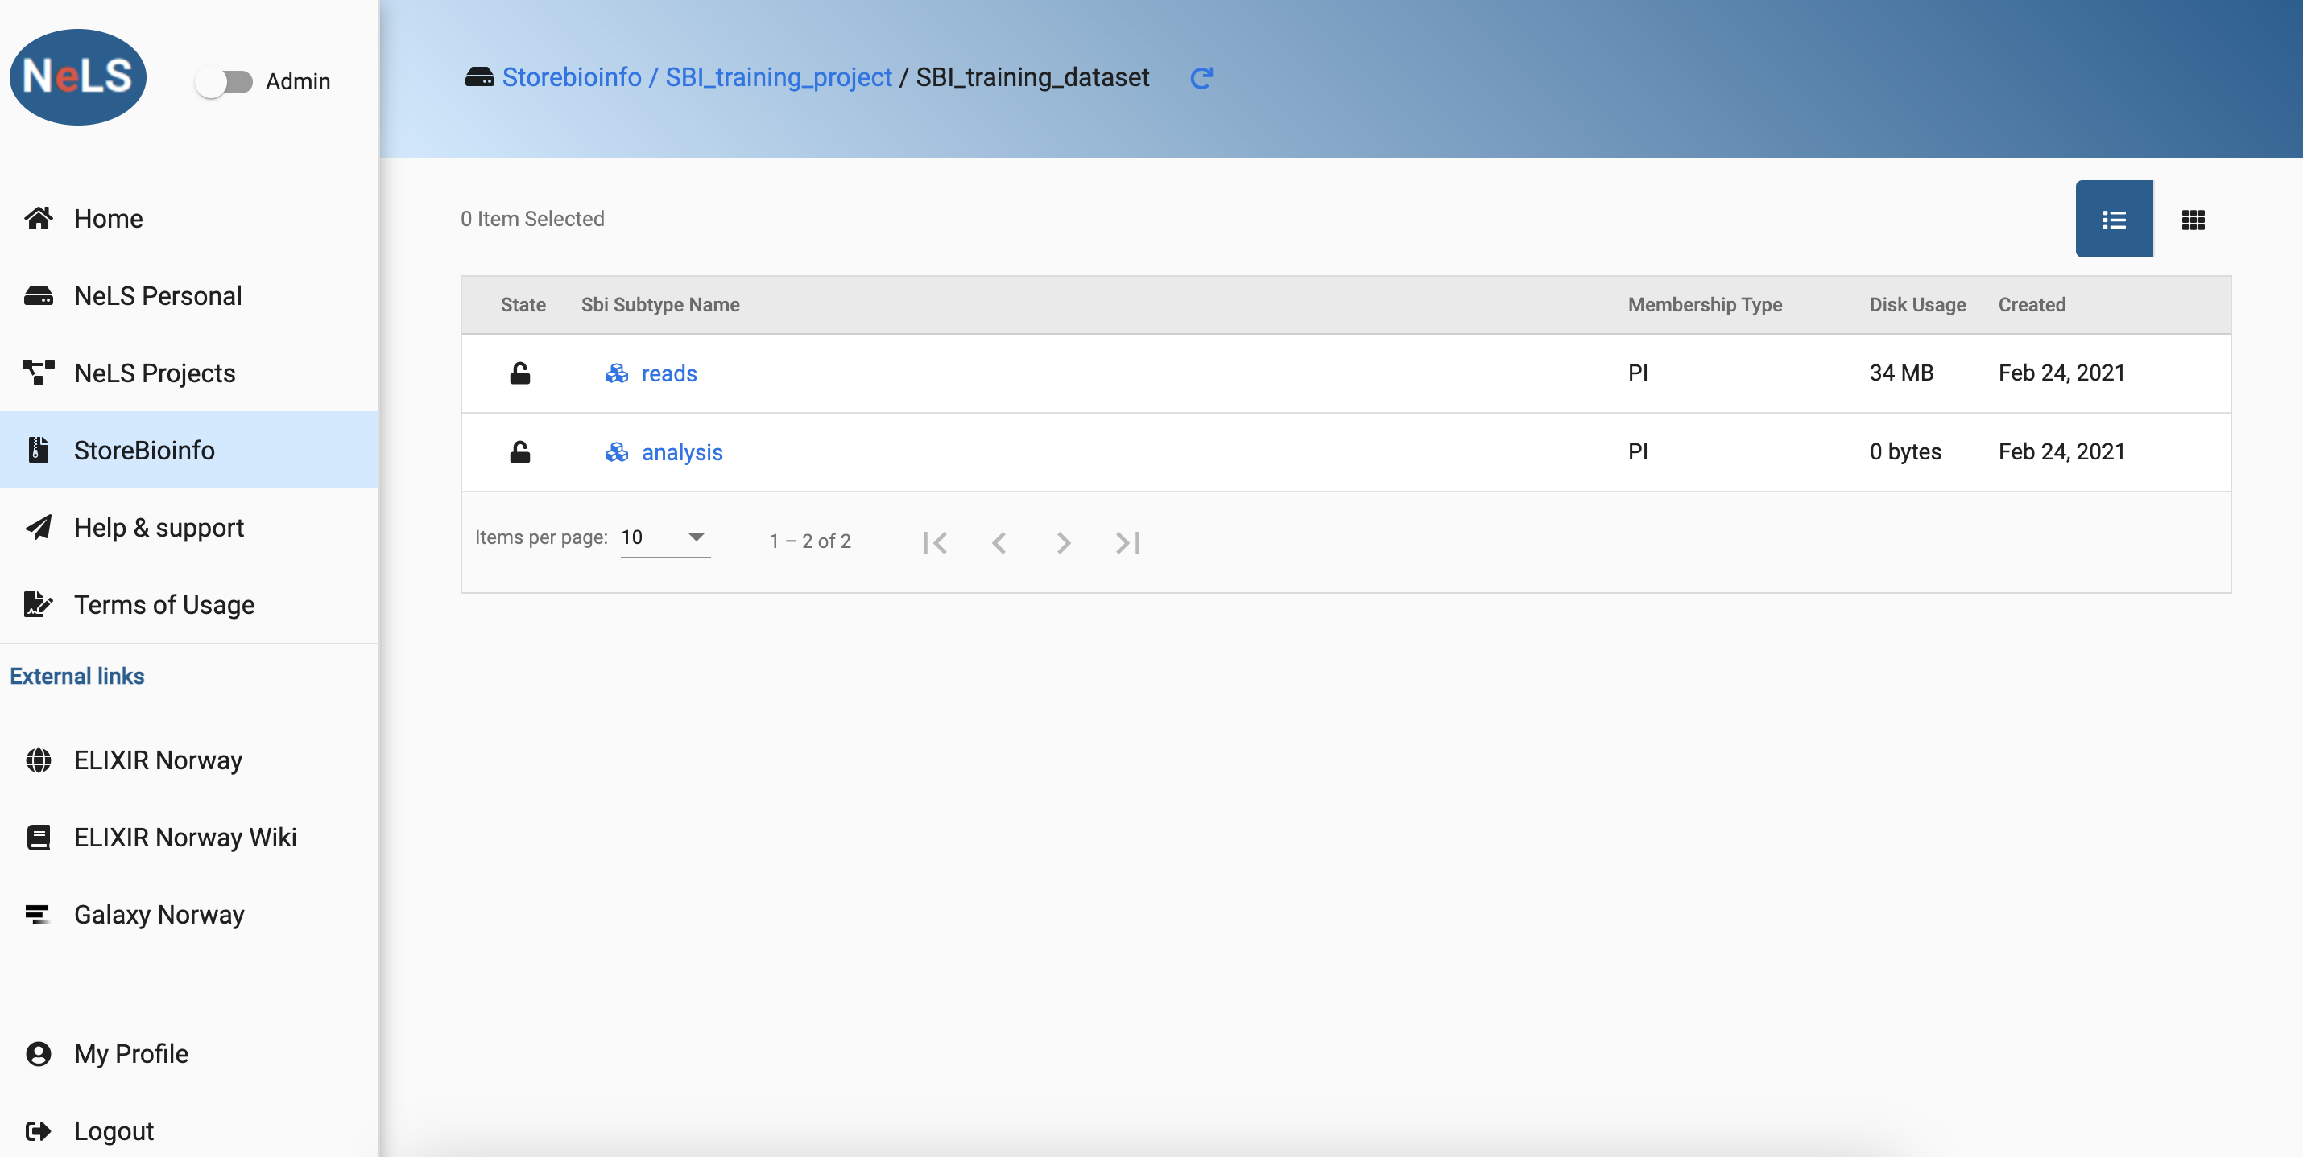
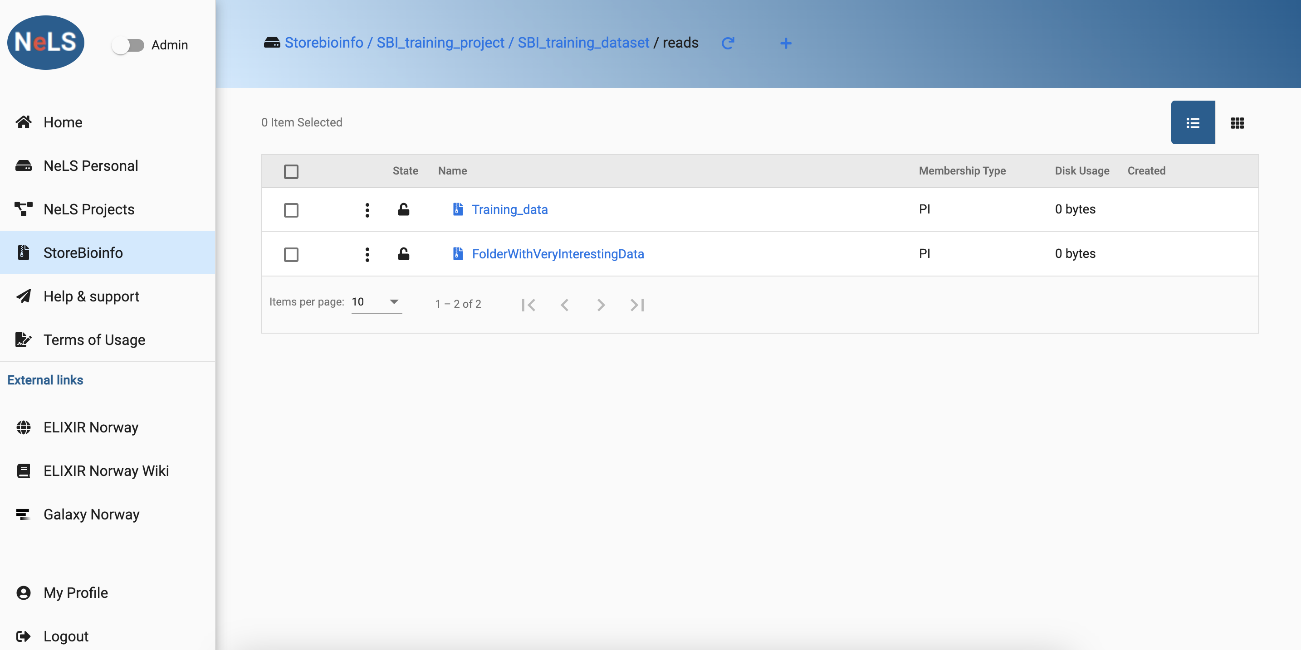
Top level structure in StoreBioinfo

Slide 12
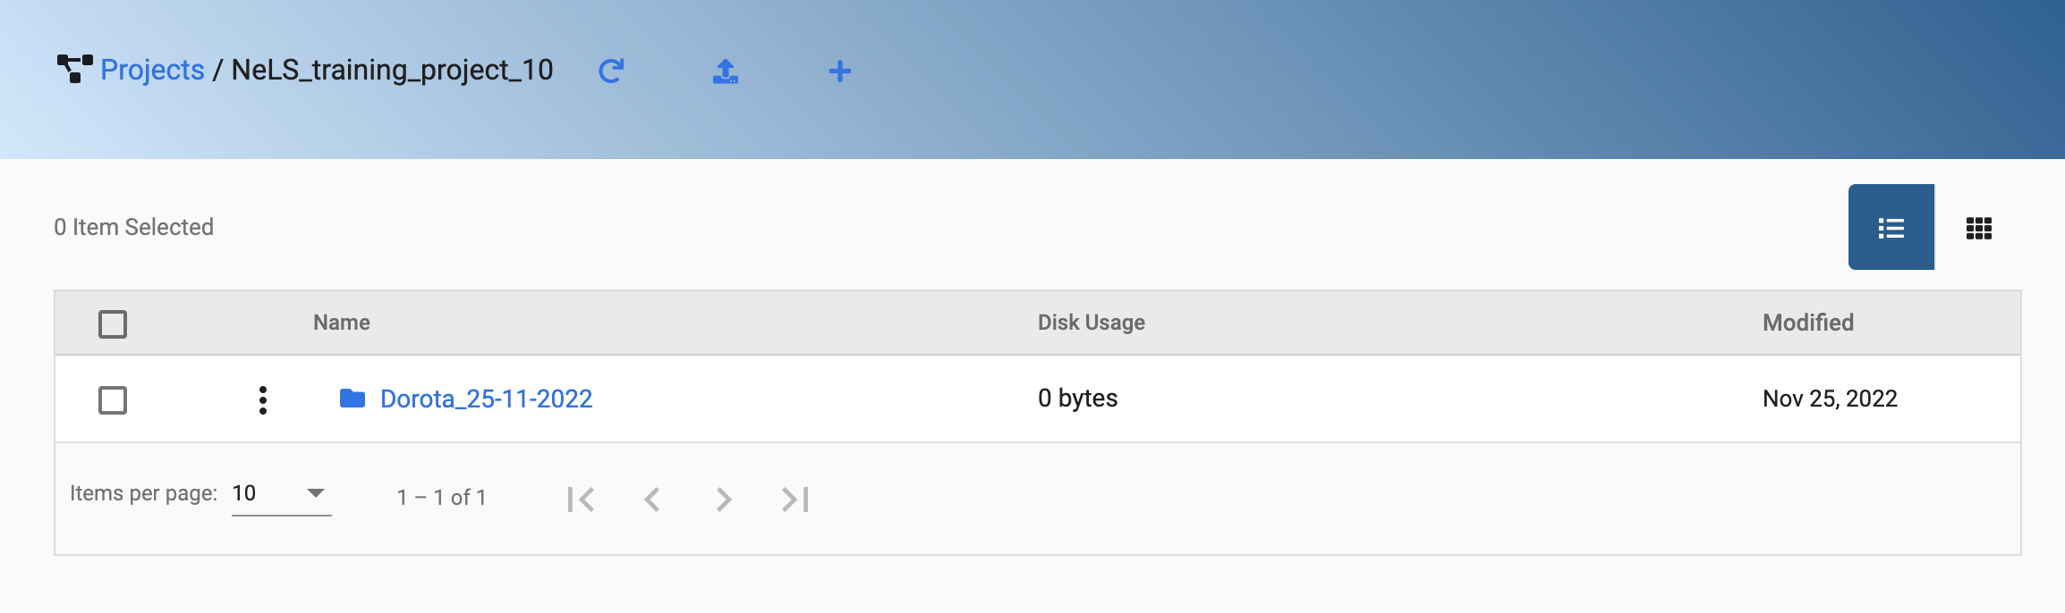
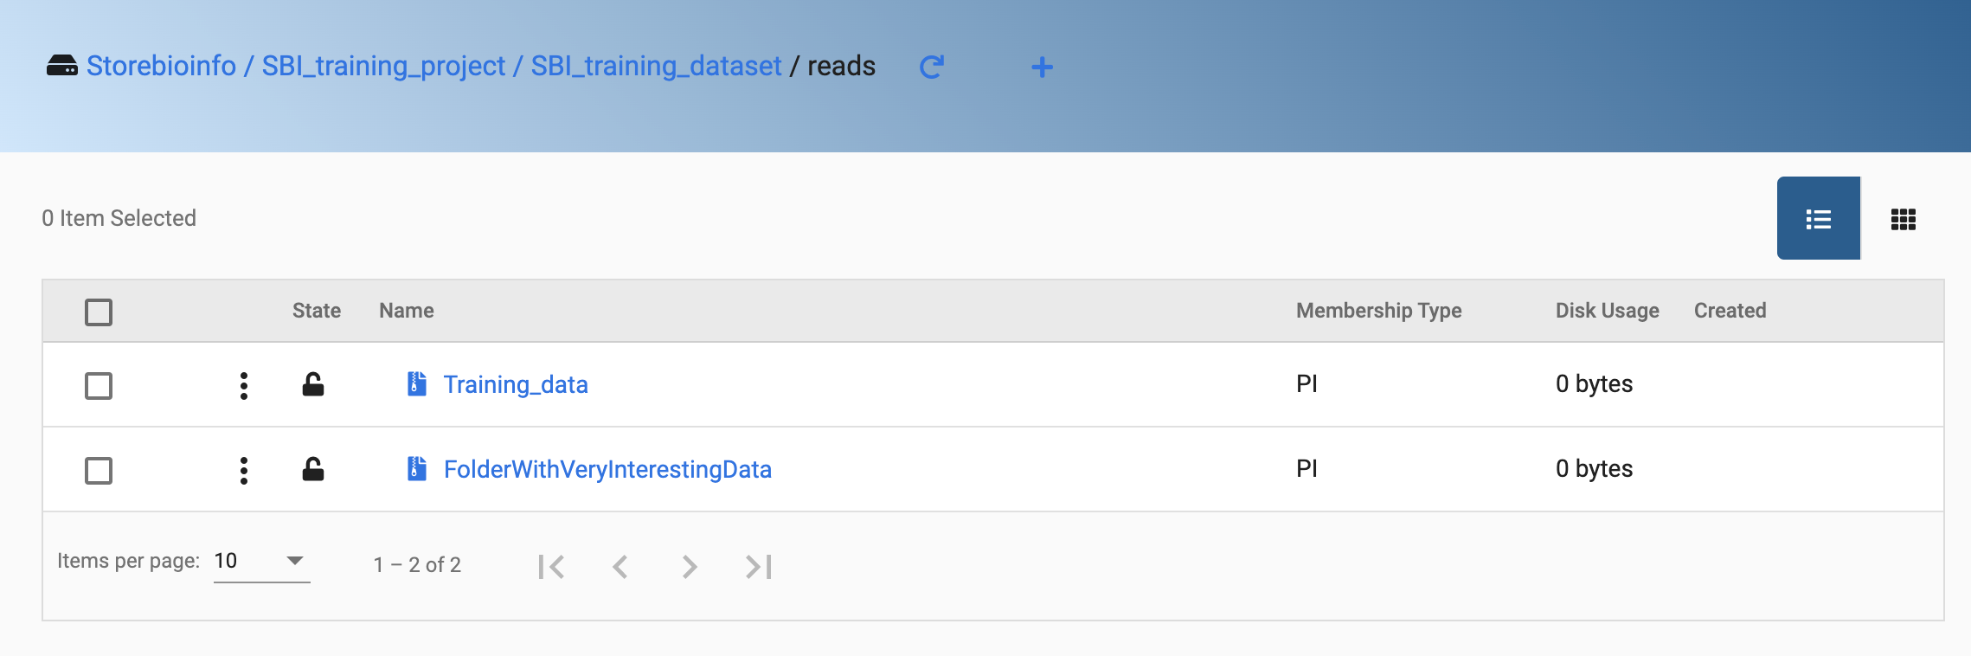
Organize data in NeLS before transfer to SBI
Prepare first in NeLS and do bulk transfer operations. Transferring single files is not efficient.

Slide 13
Questions before we start the hands-on ?
Notes:
Either with FEIDE login NeLS login for non-FEIDE users (eg. External collaborators)
Possible to access through the portal or through ssh (and API)

